Slide 1

2021年3月 广州一模读后续写

Slide 2
阅读下面短文，根据所给情节进行续写，使之构成一个完整的故事。
It took place in a teachers family. One day, Ben was playing basketball in the living room after school, when he accidentally threw the ball at a vase sitting on the shelf. The vase dropped to the floor and a large piece broke off. What made Ben more upset was that the vase was not a common decoration but an antique, which was handed down through generations from the 18th century. It was also his mother's favourite possession. To cover his terrible action, the terrified boy glued the pieces together hastily and put the vase back to its place.

Slide 3
阅读下面短文，根据所给情节进行续写，使之构成一个完整的故事。
As the mother herself dusted the vase every day, she naturally noticed the cracks(裂纹) that evening. To her surprise, the repair work was actually very good. At dinner time, she asked her boy if he broke the vase. Fearing punishment, the suddenly inspired boy said that a neighbour’s cat jumped in from the window and he couldn’t drive it away no matter how hard he tried. It raced around the living room and finally knocked the vase off its shelf. His mother was quite clear that her son was lying, for all the windows were closed before she left for work each morning and opened after she returned.

Slide 4
However, in the face of her son’s nervous eyes and the suspicious looks of the other family members, Ben’s mother remained calm. She realized she shouldn’t just simply blame and punish her son for lying. She came up with another idea.
Before going to bed, the boy found a note from his mother in his room, asking him to go to the study at once. The boy thought he would now be punished but, as he had already lied, he was determined to deny everything to the end, no matter how angry his mum became.

Slide 5
In the study, calmly bathed in the light, his mothers face showed no sign of anger. On seeing her son push open the door and cautiously enter, she took a chocolate box out of a drawer and gave him one.
Paragraph1:
The mother said, "This chocolate is a reward for your imagination: a window-opening cat!”
Paragraph2:
Now with some chocolates in hand, the boy’s bad attitude disappeared.

Slide 6

解题思路
Para 2首句: “with some chocolates in hand”
imply
more than one bar of chocolate
What for
Para 1首句: “this chocolate is a reward”
Conclusion:
Mother gave the boy more than one chocolate and they were rewards for several reasons.

Slide 7
融洽度：回扣原文
人物关键句
Description about the boy: Ben, the son
1.the terrified boy glued the pieces together
2.Fearing punishment, the suddenly inspired boy said that a neighbour’s cat jumped in
Conclusion:
Ben was so frightened that he told a lie.

Slide 8
Description about the mother
融洽度：回扣原文
人物关键句
1.she naturally noticed the cracks
2. To her surprise, the repair work was actually very good
3. His mother was quite clear that her son was lying
4. In the face of her son’s nervous eyes and the suspicious looks of the other family members. Ben’s mother remained calm.
5. Instead of simply blaming ...She came up with another idea.
Conclusion:
Mother tried to find what was good about son ,hopful for his reflection and admission.

Slide 9

段落构建思路
Para 1
The mother said, “This chocolate is a reward for your imagination: a window-opening cat! ”
母亲给儿子几（三）个巧克力的场景及儿子情感和认知的逐渐变化
思考：假如是三颗巧克力，Ben的情感和认知怎么梯度变化？
argue的程度？一赖到底？
for his good repairing work/his kindness for not letting mum sad/

Slide 10
结局构建思路
Paragraph2:
Now with some chocolates in hand, the boy’s bad attitude disappeared.
儿子在收到几（三）个巧克力后，情感上以及认识上发生的变化？承认错误, 母子互动，主题升华？呼应前文？
another chocolate as mother’s apology? for his honesty?...

Slide 11
妈妈的人设：
careful/calm/wise/considerate/experienced
a teacher teaches her son in a special but effective way
妈妈努力不生气？强挤出一丝笑？
第一段就承认了错误？衔接？
母亲一块一块地给， 没儿子什么事儿？
主题？
诚信？
爱的教育？
智慧教育？

Slide 13
The mother said, "This chocolate is a reward for your imagination: a window-opening cat!” Astonished as he was at her reward instead of harsh scold, Ben reluctantly received it, not daring to fix his eyes on his mother’s. Then, the mother squeezed another chocolate in his hand as a praise for his topping ability to skillfully restore the broken vase. Glancing at the chocolates with hesitation, the boy timidly raised his head before his mother. Obviously, the tension on his face faded a little bit. “Now,” the mother picked out a third chocolate and softly continued, “the last chocolate. I am so sorry, my little sweetheart. I shouldn’t have laid a fragile vase at an inappropriate place, especially when there is a boy so absorbed in sports.”
.

Slide 14
The mother said, "This chocolate is a reward for your imagination: a window-opening cat!” Astonished as he was at her reward instead of harsh scold, Ben reluctantly received it, not daring to fix his eyes on his mother’s. Then, the mother squeezed another chocolate in his hand as a praise for his topping ability to skillfully restore the broken vase. Glancing at the chocolates with hesitation, the boy timidly raised his head before his mother. Obviously, the tension on his face faded a little bit. “Now,” the mother picked out a third chocolate and softly continued, “the last chocolate. I am so sorry, my little sweetheart. I shouldn’t have laid a fragile vase at an inappropriate place, especially when there is a boy so absorbed in sports.”
.

Slide 15
Now with some chocolates in hand, the boy's bad attitude disappeared. “But, Mum, I…”, attempting to make something clear, Ben awkwardly uttered nothing but some words. His mother silenced him by gently putting her finger on his lips，gave a soft kiss on his forehead and walked out of the study. Back into his room, Ben placed the three chocolates where he could see them easily. That night, Ben slept the soundest sleep. From then on, the three chocolates rang the alarm in his heart every time he intended to lie, reminding him to be honest. Sometimes, no punishment could also make a big difference to a child’s growth. There is no doubt that the wise teacher and mother mixed warm romantic humor and deep love into her careful and severe education.

Slide 16
Now with some chocolates in hand, the boy's bad attitude disappeared. “But, Mum, I…”, attempting to make something clear, Ben awkwardly uttered nothing but some words. His mother silenced him by gently putting her finger on his lips，gave a soft kiss on his forehead and walked out of the study. Back into his room, Ben placed the three chocolates where he could see them easily. That night, Ben slept the soundest sleep. From then on, the three chocolates rang the alarm in his heart every time he intended to lie, reminding him to be honest. Sometimes, no punishment could also make a big difference to a child’s growth. There is no doubt that the wise teacher and mother mixed warm romantic humor and deep love into her careful and severe education.

Slide 17
possible version
The mother said, "This chocolate is a reward for your imagination: a window-opening cat!” Astonished as he was at her reward instead of harsh scold, Ben reluctantly received it, not daring to fix his eyes on his mother’s. Then, the mother squeezed another chocolate in his hand as a praise for his topping ability to skillfully restore the broken vase. Glancing at the chocolates with hesitation, the boy timidly raised his head before his mother. Obviously, the tension on his face faded a little bit. “Now,” the mother picked out a third chocolate and softly continued, “the last chocolate. I am so sorry, my little sweetheart. I shouldn’t have laid a fragile vase at an inappropriate place, especially when there is a boy so absorbed in sports.”
Now with some chocolates in hand, the boy's bad attitude disappeared. “But, Mum, I…”, attempting to make something clear, Ben awkwardly uttered nothing but some words. His mother silenced him by gently putting her finger on his lips，gave a soft kiss on his forehead and walked out of the study. Back into his room, Ben placed the three chocolates where he could see them easily. That night, Ben slept the soundest sleep. From then on, the three chocolates rang the alarm in his heart every time he intended to lie, reminding him to be honest. Sometimes, no punishment could also make a big difference to a child’s growth. There is no doubt that the wise teacher and mother mixed warm romantic humor and deep love into her careful and severe education.
利用文章线索有效衔接
基于文章主题创写故事情节
生动细节描写体现母亲春风化雨的独特教育方式
首尾呼应，揭示文章主题

Slide 18
silence：to make sb/sth stop speaking or making a noise
使安静；使不说话
她瞪了他一眼，他就不作声了
She silenced him with a glare.

Slide 19
以一篇下水作文分析如何回扣原文及铺垫，达到融洽度高
Para 1 The mother said, “This chocolate is a reward for your imagination: a window-opening cat! ” As his mother handed it to him, Ben hesitantly took over the bar of chocolate, with butterflies in stomach and wondering what his mom was up to. Soon enough his mother palmed him with another bar, saying “this is for your excellent repairing work.” Ben’s eyes were wide-open, never having the thought that his mom would handle it in such a way. Then his mother pressed the third bar of chocolate on him and told him with a steady voice “This third one was to praise your determination of not letting me know and to handle it on your own.”

Slide 20
以一篇下水作文分析如何给予一个合情合理的结局，达到融洽度高
Para 2 Now with some chocolate in hand, the boy’s bad attitude disappeared. He nibbled his lower lip and couldn’t control anymore. “Mother,” he confessed, “as a matter of fact, I lied to you.” He paused to choke back his tears and continued “there is no such thing as a cat jumping into the living room, and it was I who broke the vase.” He looked into his mother’s eyes earnestly, saying “I thank you not expose me in front of others; I thank you deal with my wrongs with kindness and wisdom; and I thank you teach me the rule – honesty is the best policy.”

Slide 21
stress sth into/onto sth to put sth in a place by pushing it firmly 将…塞进；把…按入
他把一枚硬币塞进她手里，然后继续向前走。
He pressed a coin into her hand and moved on.
to move in the direction mentioned by pushing （向…）拥挤，推搡着移动
摄影记者们挤在英雄身边。
The photographers pressed around the hero.
一大堆恼人的心事涌上他的心头。
A host of unwelcome thoughts were pressing in on him.

Slide 22
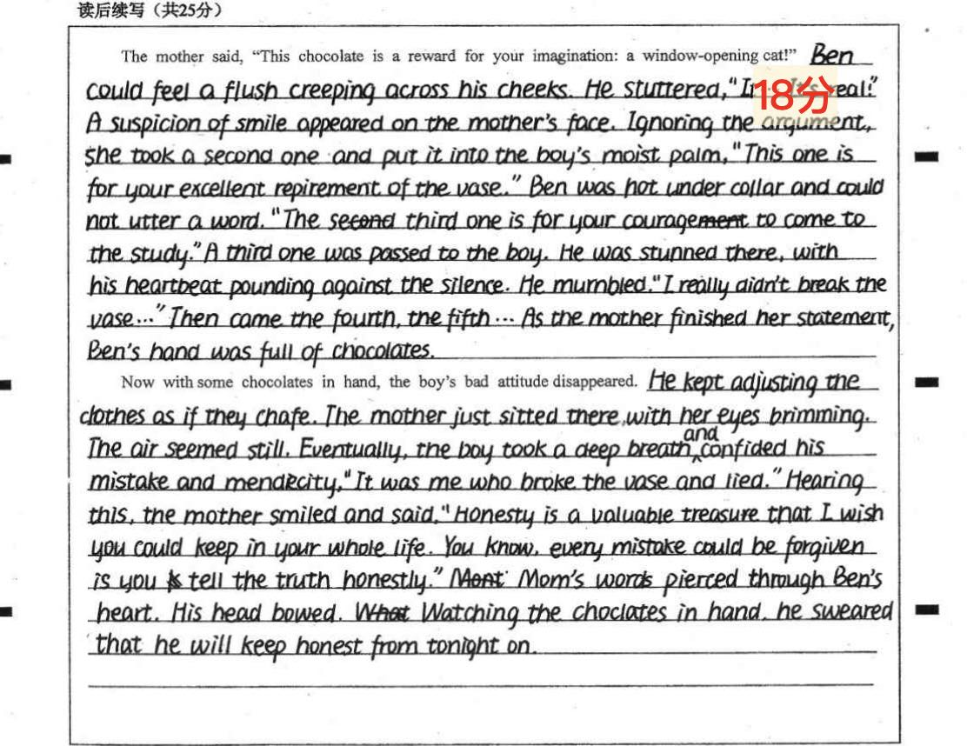
续写点评：
1. 文章整体情节合理
2. 语言生动；书写工整
3. 续写首段未能抓住情感变化有效衔接，细节描写较多但是缺乏层次感
4，能点题，若能照应文章首句呼应则更好

Slide 23
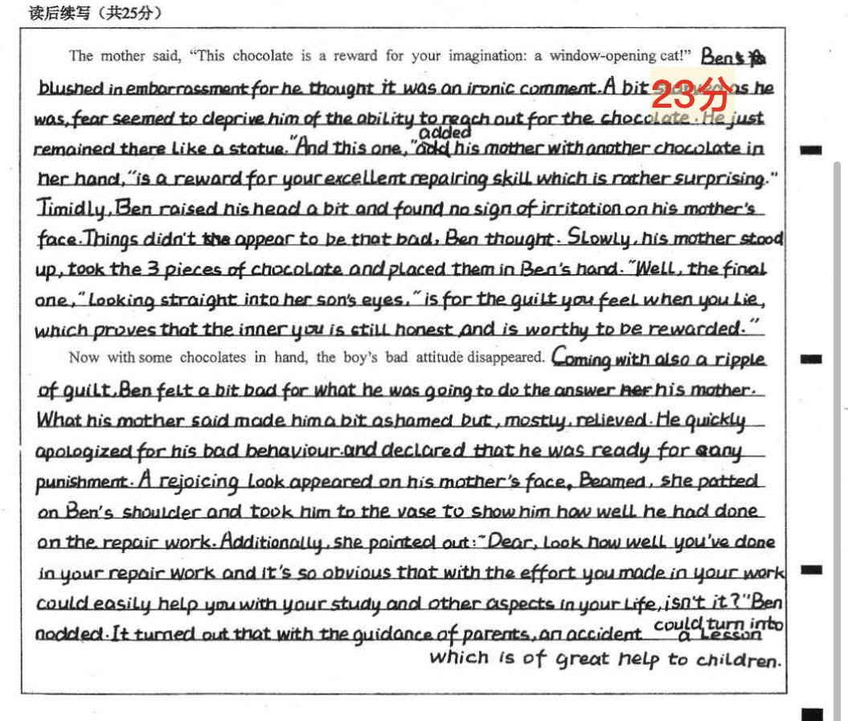
续写点评：
1. idea： 情节合理；
2. organization： 逻辑衔接合理
3.word choice:语言生动，情感解读到位，细节能服务于主题
3. sentence fluency:高级句式使用较多,不同句子开头
4. voice：与原文叙事风格保持大体一致
5. 有效点题升华文章主题

